Slide 1
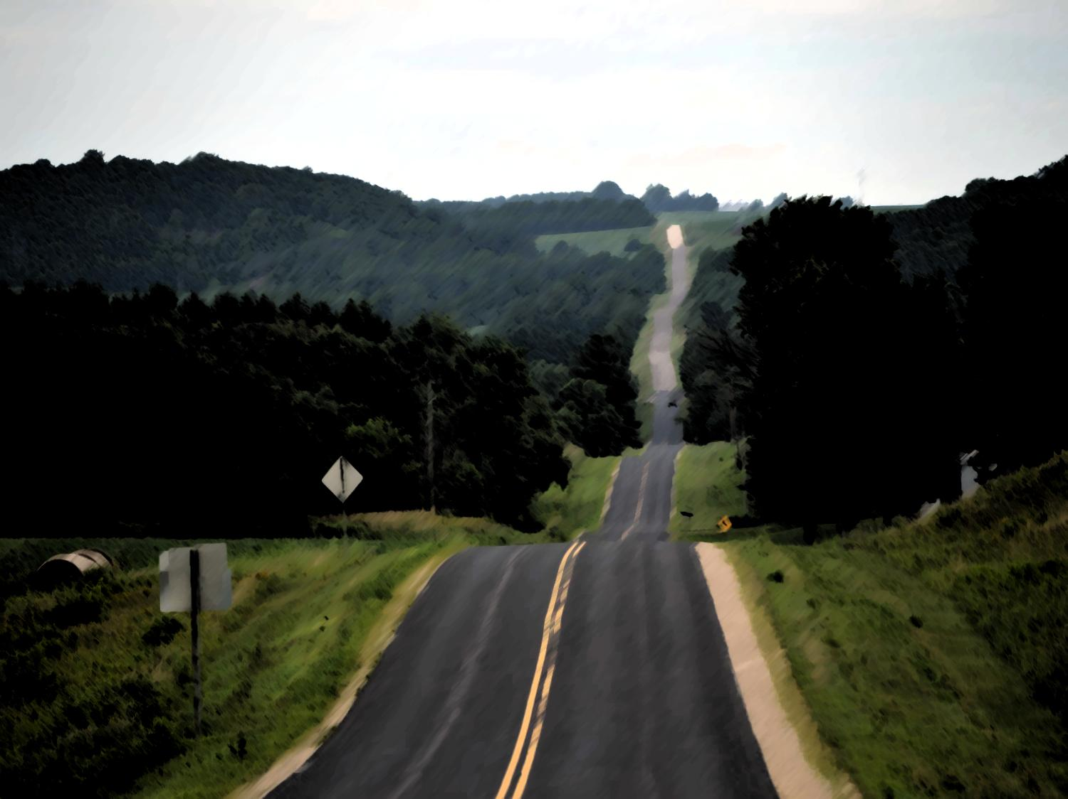
Changes to Implement of Husbandry laws Act 377
Presented by:
UW-Extension
Wisconsin Farm Bureau
Wisconsin Department of Transportation

Slide 2
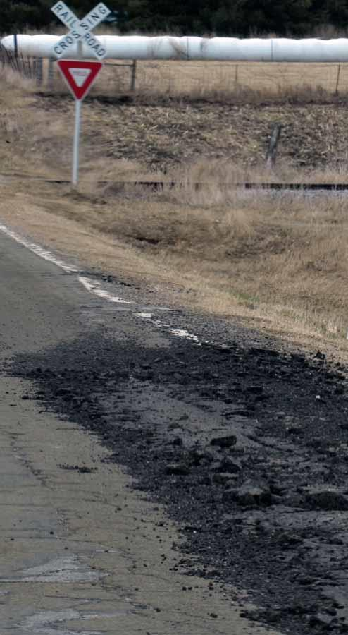
Why the change?
Equipment increasing in size and weight
Update statutory definition of IoH
Need to maintain roads – balancing agriculture’s need and town/county responsibility
Provide safe roads and bridges for all
Notes:
Previously 2 different def. of IoH equipment size and weight to be legal on the roads in 2014

Slide 3
Wisconsin Act 377
IoH Study group provided recommendations with input from town hall meetings
Legislation leadership by Senator Petrowski and Representative Ripp
SB509 included discussion by numerous agricultural organizations and agencies and local government
Signed by Governor Walker on April 23, 2014
Notes:
IoH Study group established in Fall 2012 – WisDOT & DATCP and over 20 representatives from ag, towns, county assns.
Recommendations provided with input of 1200 people @ six Town Hall meetings

Slide 4
What changed?
Definitions for IoH and Ag CMV
Size and Weight Limits
Disclosure in Sales
Lighting and Marking Requirements
Rules of the Road
“No-fee Permits”
Notes:
Items to be covered in presentation

Slide 5
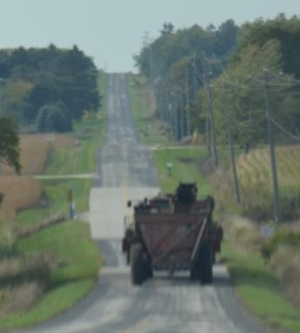
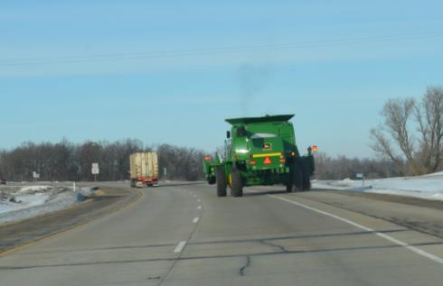
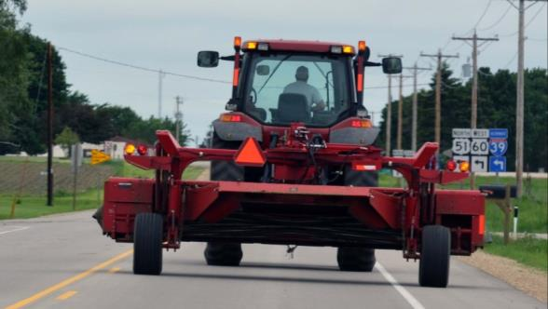
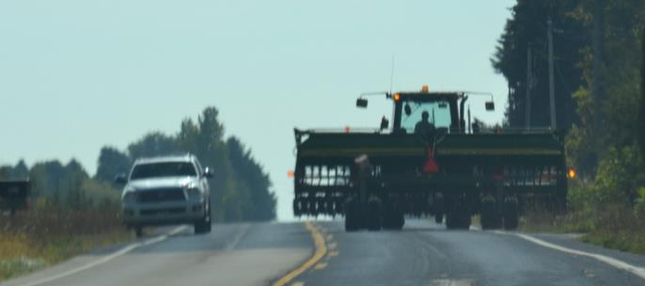
Implement of Husbandry (IoH)
Notes:
There a variety of farm equipment used to support WI strong agricultural industry. Updating the regulations to reflect the variety of types of self-propelled and towed equipment was necessary but no small undertaking.

Slide 6
IoH Definition
340.01(24)(a)
A self-propelled or towed vehicle manufactured, designed, or reconstructed to be used and that is exclusively used in the conduct of agriculture.
Effective- 4-24-14
Notes:
There is now only one def of IoH. The def. in the registration section is deleted

Slide 7
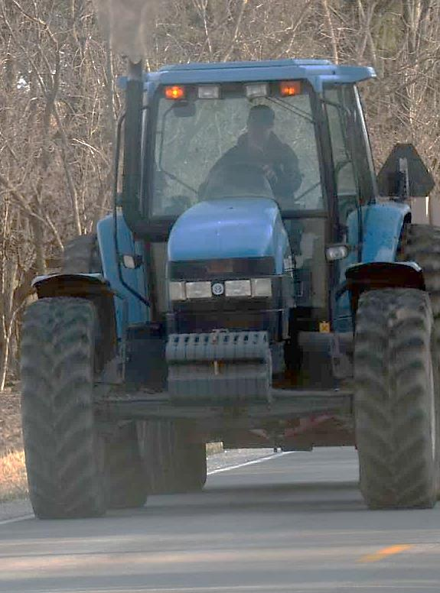
Category A
Farm Tractor

Slide 8
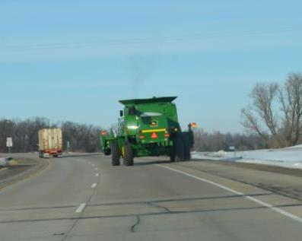
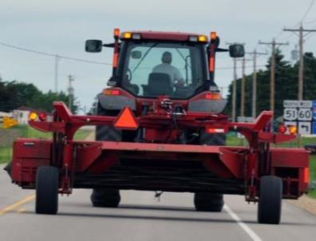
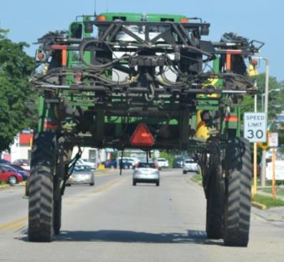
Category B
Self-propelled combine, forage harvester or self-propelled fertilizer or pesticide application equipment but not including manure application equipment;
towed tillage, planting, and cultivation equipment and its towing power unit;
or another self-propelled vehicle that directly engages in harvesting farm products, directly applies fertilizer, spray or seeds but not manure, or distributes feed to livestock.
Notes:
WisDOT opinion that a farm tractor is included in Category B as a towing power unit.

Slide 9
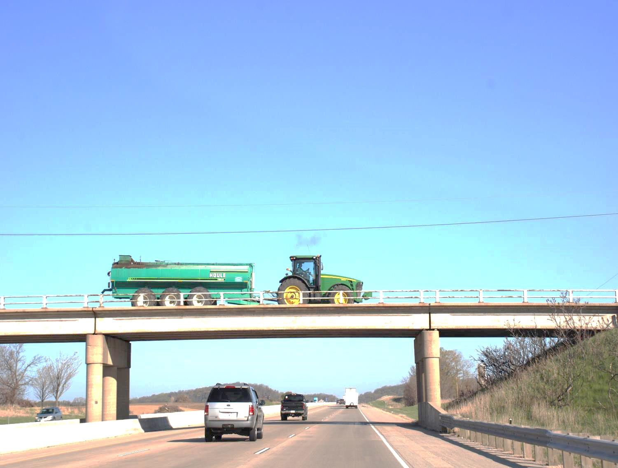
Category C
A farm wagon, farm trailer, manure trailer, or trailer adapted to be towed by or to tow or pull, another implement of husbandry.
Notes:
This may not be the appropriate graphic. Though the bridge structure was a good visual reminder of the road factor and this is where manure trailer are recognized.

Slide 10
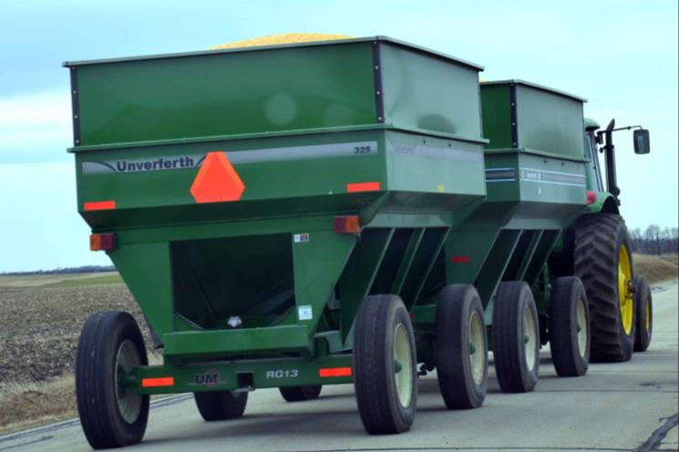
IoH Definition – cont.
A combination of vehicles in which each vehicle in the combination is an IoH or
in which an IoH farm wagon, farm trailer, manure trailer is towed by a farm truck, farm truck tractor, or motor truck*.
Notes:
Second bullet means that type of power unit does not change that the trailer(s) are still IoH.
It does not make the power unit an IoH

Slide 11
IoH Definition – cont.
IoH does not include any of the following:
1. An agricultural commercial motor vehicle.
2. A vehicle that is a commercial motor vehicle under 49 CFR 390.5*:
Has a gross vehicle weight rating or
gross combination weight rating, or
gross vehicle weight or
gross combination weight, of
10,001 pounds or more, whichever is greater
Notes:
Federal CMVs are referenced in this definition – not the state. (10,001+ lbs versus 26,001+ pounds)
Motor Trucks less than 10,001 lbs are not “manufactured, designed, or reconstructed to be used exclusively” in the conduct of agriculture.

Slide 12
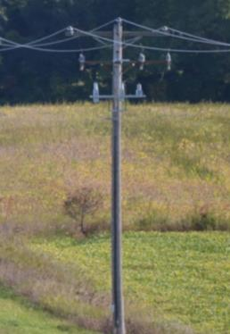
IoH Height
No height limit
Operator of the IoH is responsible for ensuring that there is adequate height clearance between the IoH and any overhead structure or obstruction.
Effective- 05-24-14
Notes:
Permit language – adequate clearance is 3 inches between vehicle and structure

Slide 13
Length
Without permit:
Single IoH - 60 feet
Two IoH vehicle combination - 100 feet
3 IoH vehicle combination (train)
No more than 100 feet with speed restriction of 25 mph or less or 70 feet at speed greater than 25 mph
“No-Fee Permit” may be available
Effective- 05-24-14
Notes:
In old law there was no length limitation for IoH single and 2 veh combinations. Act 377 put length restrictions in place.

Slide 14
IoH Width
Tractor width limits removed, including when operated on Interstate.
No width limit for IoH operated on a highway.
Additional lighting and marking requirements for “wide” IoH as of November 1, 2015.
Effective- 11-01-15
Notes:
No width limits – but added lighting and marking to increase safety

Slide 15
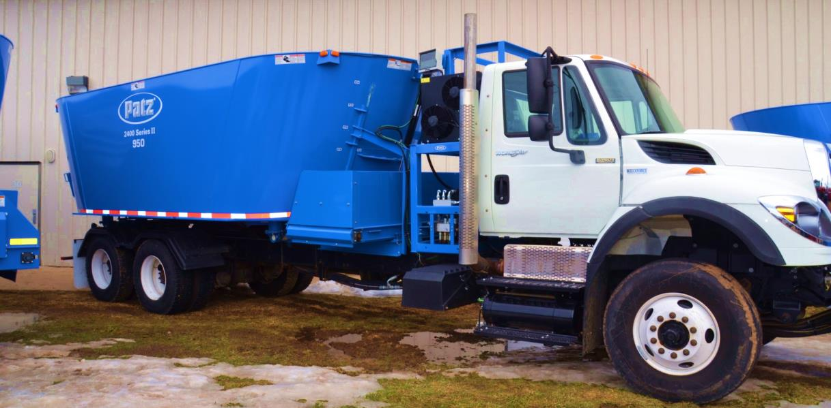
Agricultural Commercial Motor Vehicle (Ag CMV) 340.01 (1o)
Effective- 4-24-14

Slide 16
Agricultural CMV Definition
An Ag CMV is a commercial motor vehicle to which all of the
following apply:
Substantially designed or equipped, or materially altered from its original construction, for the purpose of agricultural use
Designed and manufactured primarily for highway use
Manufactured to meet federal motor vehicle safety standard certification label requirements 49 CFR 567, after 1970
Used exclusively in the conduct of agricultural operations
Is directly engaged in harvesting farm products, directly applies fertilizer (manure included here), spray or seeds to a farm field, or distributes feed to livestock
Notes:
a- Adding an extension to the top of a dump truck box so a crop can be unloaded into the dump box is not substantially altered. Trucks and trailers designed from the manufacturer for Ag purposes meet this criteria, example Meyers grain trucks or trailers.
b- The original design purpose was to be operated on a highway, not off road. Most military vehicles are not designed for hwy use.
c- Must have FMVSS decal or be older than 1970 (FMVSS started in 1970)
d- other use not allowed- easiest one of the 5 to explain
e- if the vehicle does not drive in the field actually harvesting the crop (next to combine or forage harvester) it is not an Ag CMV. If it only drives into the field to be loaded and then hauls the crop away it is transporting not “directly harvesting.” Distributes feed to livestock is a TMR mixer. Mixers the feed and nutrients and then directly feeds them. Not for moving feed from one farm to another for stockpiling or other storage.

Slide 17
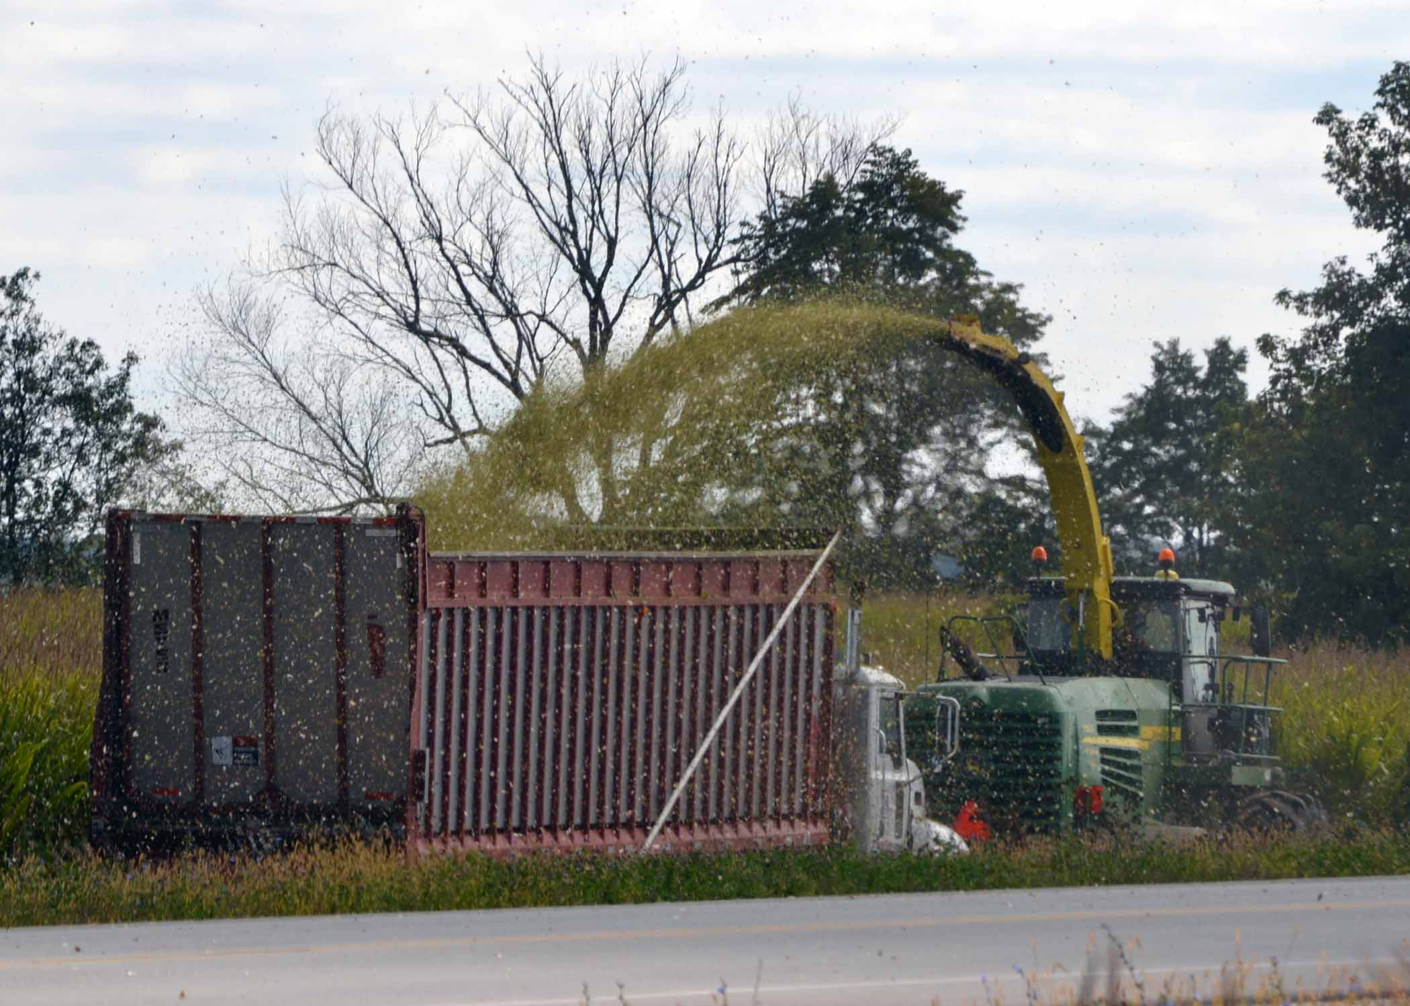
Is it an Ag CMV?
Insert photo of vehicle to analyze with five questions

Slide 18
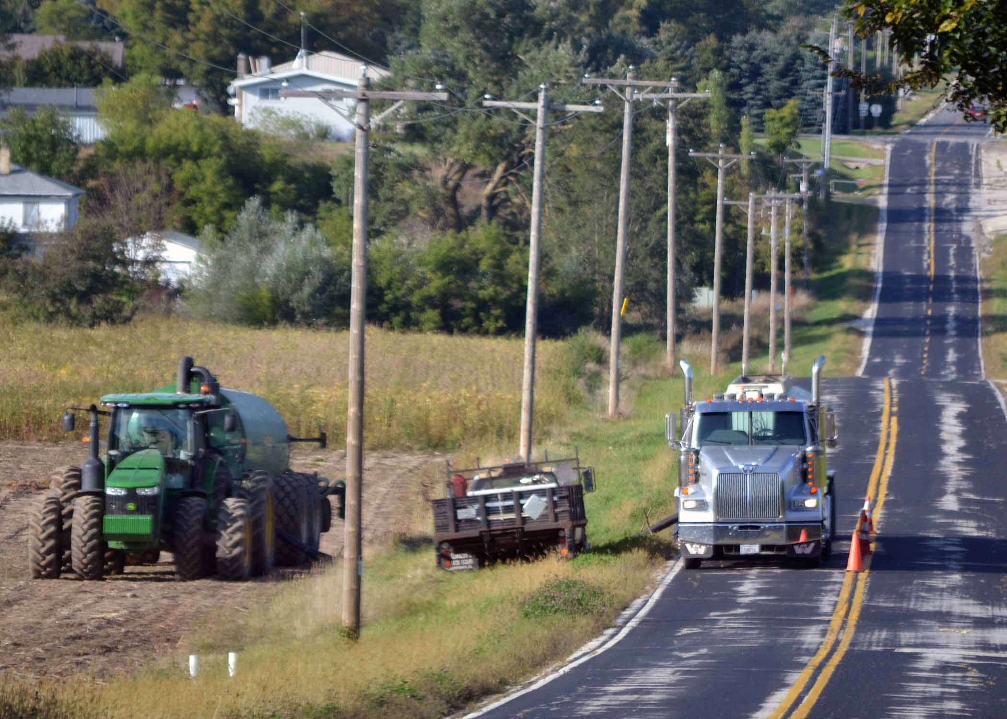
Is it an Ag CMV?
Insert photo of vehicle to analyze with five questions

Slide 19
Ag CMV
Ag CMV self-certification form available
Ag CMV and CMV must meet all State and Federal safety standards and inspections
Ag CMVs exempt from registration fees
Notes:
The Ag CMV cert is not required to be used. It is to help when a person is pulled over to show the LE officer what an Ag CMV is and that the owner certifies the criteria. Removed IoH registration section def.

Slide 20
Ag CMV Dimensions
Height: 13 feet 6 inches
Width: 10 feet including all accessories or attachments except:
The tires, fenders or fender flares of Ag CMVs spraying pesticides or spreading lime or fertilizer (not manure) may extend up to 12 feet.
Effective- 05-24-14
Notes:
Must explain that the body width and accessories are 10 feet only the tires, fenders and fender flares can be up to 12 feet wide.

Slide 21
Ag CMV Dimensions
Without Permit - Length:
45 feet single Ag CMV vehicle (1 vehicle)
70 feet for TWO VEHICLE COMBINATION
100 feet with speed restriction of 25 mph or less or 70 feet at speed greater than 25 mph for Ag CMV pulling 2 IoH or 2 empty* pressurized tanks or 2 empty* trailers (3 vehicles or train)
No Fee Permit may be available for length
*empty = no more than 20% full
Notes:
Ag CMV get same 1 and 2 vehicle lengths as an other single vehicle or two vehicle combination. Ag CMV train or three vehicle combination Gets extra allowance.

Slide 22
Weight – IoH and Ag CMV
Weights GENERALLY increased by 15% for IoH and Ag CMV over the Federal Bridge Formula (FBF).
Maximum GVW 92,000 lbs
Maximum Axle weight 23,000 lbs.
New IoH/Ag CMV Weight Table reflects necessary number of axles and axle spacing
Effective- 04-23-14
Notes:
Former Limits 80,000 GVW and 20,000 axle weight
Weight limitations on vehicles and vehicle combinations based on number of axles and spacing of axles. 348.15(3)(c) Table
Seasonal and special road limitations or postings apply
General permits from local Maintaining authority (MA) could be issued
All changes to 348.15 effective 04-23-14
Past WI Supreme Court decision made WI keep the old weights on 4,5 and 6 axles single units. These weights were over 15% of FBF. Another 15% would mean 30% over FBF. Roads and structures could not handle the extra weight without severe damage

Slide 23
Weight – IoH and Ag CMV
Please note:
In 348.15(3)(c) Single vehicles with 4, 5 and 6 axles are already set 15% over the FBF.
These vehicles do not get additional allowances in the new IoH/Ag CMV Weight Table
New IoH/Ag CMV weight allowances DO NOT apply on the Interstate Highway System
Effective- 04-23-14
Notes:
All changes to 348.15 effective 04-23-14
Past WI Supreme Court decision preserved former weights for 4,5 and 6 axles single units. These weights were over 15% of FBF.
Another 15% would mean 30% over FBF. Roads and structures could not handle the extra weight without severe damage

Slide 24
Weight – IoH and Ag CMV
Implement of Husbandry/Ag CMV Maximum Weight Limitations Table
[§348.15(3)(g)]
A - Distance in feet between foremost and rearmost axles of a group* | B - 2 axles of a vehicle or combination of vehicles | C - 3 axles of a vehicle or combination of vehicles |  | D - 4 axles of a vehicle or combination of vehicles |  | E - 5 axles of a vehicle or combination of vehicles |  | F - 6 axles of a vehicle or combination of vehicles |  | G - 7 Axles of a vehicle or combination of vehicles | H - 8 Axles of a vehicle or combination of vehicles
4 | 39,500
5 | 40,500
6 | 41,500
7 | 43,000 | 47,500
8 | 44,000 | 48,500
9 | 45,000 | 49,500
10 | 46,000 | 50,500 |  | 56,000
11 |  | 51,000 |  | 57,000
12 |  | 52,000 |  | 57,500
13 |  | 53,000 |  | 58,500
14 |  | 53,500 |  | 59,500 |  | 65,500
15 |  | 54,500 |  | 60,000 |  | 66,000
16 |  | 55,500 |  | 61,000 |  | 67,000
17 |  | 56,500 |  | 61,500 |  | 67,500 |  | 74,000
18 |  | 57,000 |  | 62,500 |  | 68,500 |  | 75,000
19 |  | 58,000 |  | 63,000 |  | 69,000 |  | 75,500
20 |  | 59,000 |  | 64,000 |  | 70,000 |  | 76,000
21 |  | 60,000 |  | 64,500 |  | 70,500 |  | 77,000 |  | 83,500
22 |  | 60,500 |  | 65,500 |  | 71,500 |  | 77,500 |  | 84,000
23 |  | 61,500 |  | 66,000 |  | 72,000 |  | 78,000 |  | 84,500
24 |  | 62,500 |  | 67,000 |  | 72,500 |  | 79,000 |  | 85,500 | 92,000
Axles must be at least 42 inches apart to qualify as a separate axle and must bear at least 8% of the GVW.
Notes:
The increased weight allowance for implements of husbandry and agricultural commercial motor vehicles applies in lieu of, not in addition to,
any other increased weight allowance for implements of husbandry authorized under this chapter.

Slide 25
Weight – IoH and Ag CMV
25 |  | 63,000 |  | 67,500 |  | 73,500 |  | 79,500 |  | 86,000
26 |  | 64,000 |  | 68,500 |  | 74,000 |  | 80,500 |  | 86,500
27 |  | 65,000 |  | 69,000 |  | 75,000 |  | 81,000 |  | 87,500
28 |  | 66,000 |  | 70,000 |  | 75,500 |  | 81,500 |  | 88,000
29 |  | 66,700 |  | 71,000 |  | 76,500 |  | 82,500 |  | 88,500
30 |  | 67,275 |  | 71,500 |  | 77,000 |  | 83,000 |  | 89,500
31 |  | 68,425 |  | 72,500 |  | 77,500 |  | 83,500 |  | 90,000
32 |  | 69,000 |  | 73,000 |  | 78,500 |  | 84,500 |  | 90,500
33 |  |  |  | 74,000 |  | 79,000 |  | 85,000 |  | 91,500
34 |  |  |  | 74,500 |  | 80,000 |  | 86,000 |  | 92,000
35 |  |  |  | 75,500 |  | 80,500 |  | 86,500
36 |  |  |  | 76,000 |  | 81,500 |  | 87,000
37 |  |  |  | 77,000 |  | 82,000 |  | 88,000
38 |  |  |  | 77,500 |  | 83,000 |  | 88,500
39 |  |  |  | 78,000 |  | 83,500 |  | 89,500
40 |  |  |  | 79,000 |  | 84,000 |  | 90,000
41 |  |  |  | 80,000 |  | 85,000 |  | 90,500
42 |  |  |  | 80,500 |  | 85,500 |  | 91,500
43 |  |  |  | 81,500 |  | 86,500 |  | 92,000
44 |  |  |  | 82,500 |  | 87,000 |  | 86,825
45 |  |  |  | 83,000 |  | 88,000 |  | 87,400
46 |  |  |  | 84,000 |  | 88,500 |  | 88,550
47 |  |  |  | 84,500 |  | 89,000 |  | 89,125
48 |  |  |  | 85,500 |  | 90,000 |  | 89,700
49 |  |  |  | 86,000 |  | 90,500 |  | 90,275
50 |  |  |  | 87,000 |  | 91,500 |  | 91,425
51 |  |  |  | 87,500 |  | 92,000 |  | 92,000
52 |  |  |  | 88,500
53 |  |  |  | 89,000
54 |  |  |  | 90,000
55 |  |  |  | 90,500
56 |  |  |  | 91,500
57 |  |  |  | 92,000
*Measuring: [348.15 (5m)] The distances between the foremost and rearmost of a group of axles shall be measured between axle CENTERS to the nearest even foot, and when a fraction is exactly one-half foot, the nearest larger whole number shall be used. Example: 50 feet 5 inches = 50 feet; 50 feet 6 inches = 51 feet

Slide 26
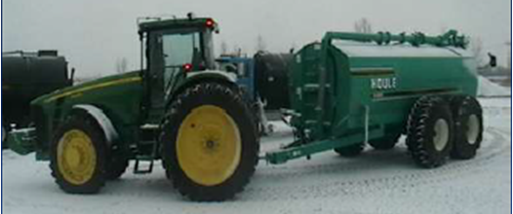
Vehicle Measurements
AXLE 1 GAUGE
AXLE 2 GAUGE
AXLE 4 GAUGE
AXLE 3 GAUGE
AXLE SPACING 1
AXLE SPACING 2
AXLE SPACING 3
Column A
AXLE 1 Weight
AXLE 2 Weight
AXLE 3 Weight
AXLE 4 Weight

Slide 27
Weight – Exemptions
Potato harvester
No axle weight limits on empty potato harvester. Requires:
One or more escort vehicles with hazard lights
No escort needed if traveling less than .5 miles

Slide 28
Weight – Category B Exemptions
Category B IoH
No axle weight limits
GVW limit applies at 92,000 lbs.
No weight limit – axle or GVW – for incidental travel (1/2 mile or less) field to field OR field to farm
Notes:
REMIND AUDIENCE OF WHAT CAT B IS

Slide 29
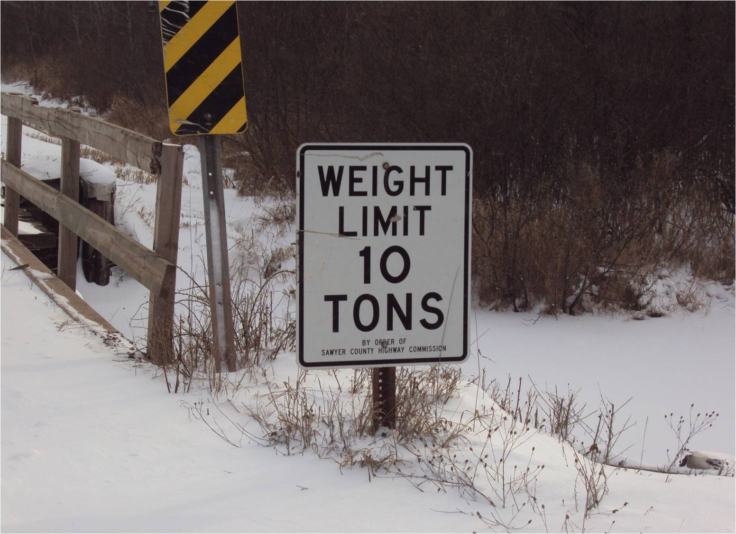
Weight – Category B Exemptions
Category B IoH
Can disregard Class B Posting (348.16 (2))
MUST OBEY seasonal or special weight posting or bridge posting (348.17)

Slide 30
Weight – Category B Exemptions
NOTE:
Axle weight limit is set on all state highways for all IoH and Ag CMVs at 23K/92K/weight table – including Category B
Local maintaining authority may pass ordinance setting 23K axle weight limit for Category B
Category B must be given an approved route
Notes:
REMIND AUDIENCE OF WHAT CAT B IS

Slide 31
Weight – Fines
Amount of overweight violation based on statutory limit in the 348.15(3)(c) table, not the IoH/AG CMV allowance 348.15(3)(g)
Example:
IoH weighing 96,000 lbs. GVW – with no permit
Violation based on max. 80,000 lbs. GVW –
not 92,000 GVW =16,000 lbs. over
1st offense citation = $2,400 (.15 per lbs.)
2nd offense citation = $2,880 (.18 per lbs.)
Notes:
Within a 12 mo period – Frequency of violation does impact level of fine
Based on the legal weight limit of the vehicle
Also applies to axle weight violations

Slide 32
State Patrol – Delayed Enforcement
Until April 15, 2015 State Patrol will only issue warnings for violations to:
IoH Category A – Farm Tractors
IoH Category B – Self-propelled IoH
The delayed enforcement period does not apply to:
Violations that occur on the Interstate Highway System
County or local law enforcement
IoH Category C
AG CMVs
Notes:
Changed from January 15th to April 15th for citations.
Reason for posting 349.16: weakness t o roadbed due to deterioration, climate, or special or temporary conditions. Roads likely to be seriously damaged or destroyed in the absence of such special limitations.
Erect signs to give reasonable notice.

Slide 33
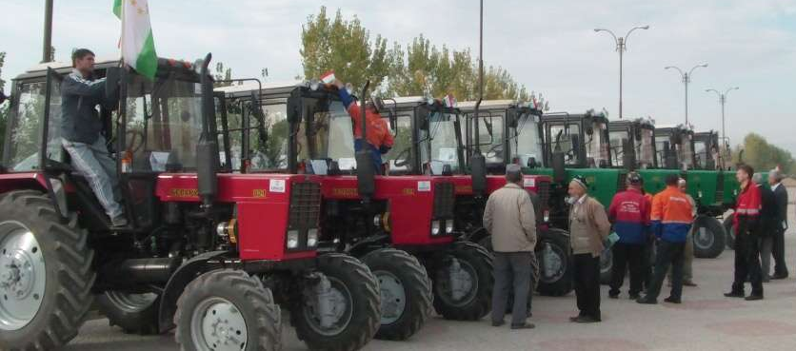
Dealer/Repair- Exemptions
The same height, width and length laws with lighting and marking for IoH apply
No weight limits for an IoH or Ag CMV while being operated or transported by an implement dealer or farmer
By an implement dealer or farmer for purposes of delivery, repair, or servicing within 75 mile radius of the farmer’s owned or leased land, or dealer’s business location
May operate on Class B roads but must obey seasonal and special postings

Slide 34
Dealer/Repair Exemptions
Projecting loads limits on side of vehicles (348.09) does not apply if the load is an IoH or Ag CMV being transported or operated by dealer or by farmer for delivery or repair
For purposes of delivery, repair, or servicing within 75 mile radius of the farmer’s owned or leased land, or dealer’s business location
Effective- 05-24-14

Slide 35
Disclosures in
Sales
Seller must provide farm equipment GVW in writing
Must have lights, reflectors, and other marking devices meeting the applicable vehicle equipment requirements based on manufactured date
Effective- 01-01-15

Slide 36
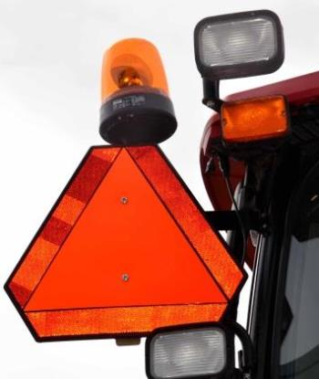
Lighting Standards
Self-propelled IoH exceeding 12 ft in width must have:
Yellow or amber rotating strobe or beacon light mounted at highest practical point
or
2 flashing amber lights visible to the front and rear
NOTE: Lights activated at all times on the highway
Effective- 11-01-15
Notes:
Lights may be positioned anywhere AND visible in both directions

Slide 37
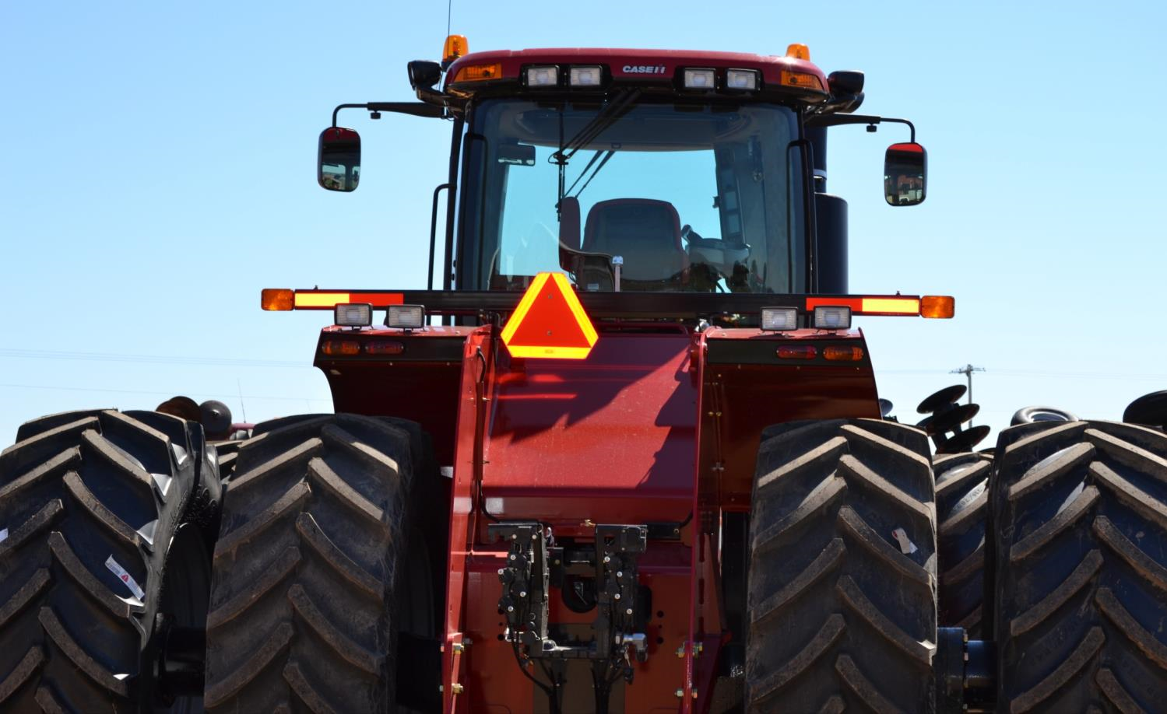
“Wide” IoH
Effective- 11-01-15
Wide IoH = Any IoH exceeding 15 feet in total width or that extend over the center of the roadway into a lane intended for the opposite direction of travel
Notes:
Second phrase means that vehicles less than 15 feet may be considered a wide IoH and need lighting and marking

Slide 38
Wide IoH- Lighting/Marking Standards
Any lamp or light required must be lighted and visible at the time of operation on a highway
At least 2 amber flashing warning lamps
Visible from both the front and rear
Visible 500 feet from the front and rear
Mounted to indicate the extreme width - but not more than 16 inches from extremities of the IoH
Effective- 11-01-15

Slide 39
Wide IoH- Lighting/Marking
Red retroreflective material:
visible to the rear
mounted within 25 inches of the extreme left and extreme right of the IoH and spaced as evenly as practicable.
such size and so maintained to be visible during the hours of darkness from all distances within 500 feet when directly in front of lawful upper beams of headlamps.
Effective- 11-01-15

Slide 40
Wide IoH- Lighting/Marking
At least 2 strips of yellow retroreflective material:
Visible to the front of the implement of husbandry.
Mounted within 16 inches of the extreme left and right of the IoH.
Such size and maintained to be visible during hours of darkness from all distances within 500 feet when directly in front of lawful upper beams of headlamps.
Effective- 11-01-15

Slide 41
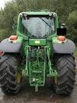
Wide IoH- Lighting/Marking
At least 2 red tail lamps mounted symmetrically to the rear
These tail lamps are not required to be hardwired to headlights.
When lighted, these tail lamps shall be capable of being seen during hours of darkness at a distance of 500 feet from the rear of the IoH
Effective- 11-01-15

Slide 42
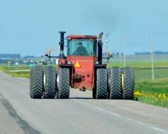
Wide IOH Exceeding 22 ft
Must have an escort vehicle
with hazard lights activated:
In front of IoH on two lane highway
Behind IoH on highway with more than two lanes
Escorts not needed for incidental travel
(1/2 mile or less)
Effective- 11-01-15

Slide 43
Wide IOH – Escort Exemption
During times other than hours of darkness
extra lighting and marking not required if:
Accompanied by an escort vehicle
operating with hazard lights activated and;
Two orange or red flags
not less than 12 inches square attached to the rear of the wide IoH
in a manner that is clearly visible
marks the extreme left and extreme right of the wide IoH
Effective- 11-01-15

Slide 44
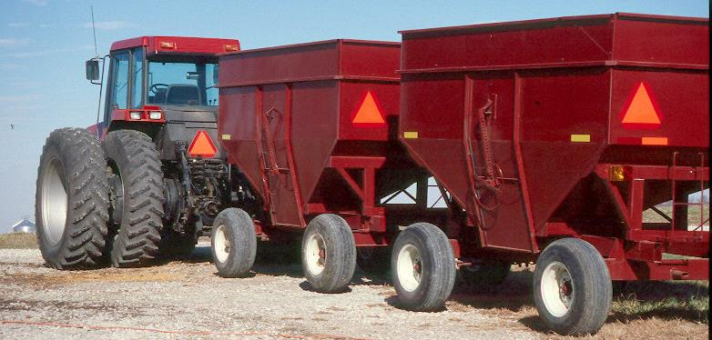
Ag Train Lighting/Marking
During hours of Darkness:
On each side of each vehicle in the train
One red or amber light or
One red or amber reflector or
One SMV symbol
The daylight flag
requirement has
been rescinded
Effective- 11-01-15
Notes:
Applies to either IoH, Ag CMV or other power unit types (truck, truck tractor, etc)
Effective date is for allowing amber lights as well as red and the removal of daylight flags.
No one should be warning or citing if they use amber prior to the effective date or no daylight flags prior to effective date.

Slide 45
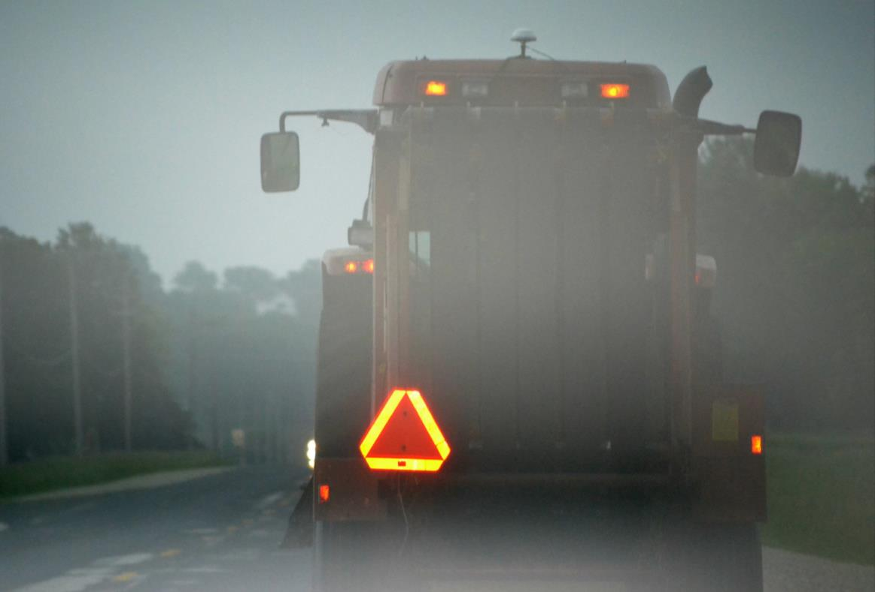
347.245 –Identification emblem on certain slow moving vehicles
Current Marking and Lighting Standards
Must be displayed on any vehicles or equipment, including animal drawn, which usually travels less than 25 mph
Displayed day or night

Slide 46
347.24 (1) – “Lamps and reflectors on nonmotor vehicles and equipment”
Current Marking and Lighting Standards
Cannot operate an implement of husbandry during the hours of darkness,
UNLESS there is at least:
2 white lamps visible ahead
and
2 red tail lamps
or
2 red reflectors displayed
on the rear

Slide 47
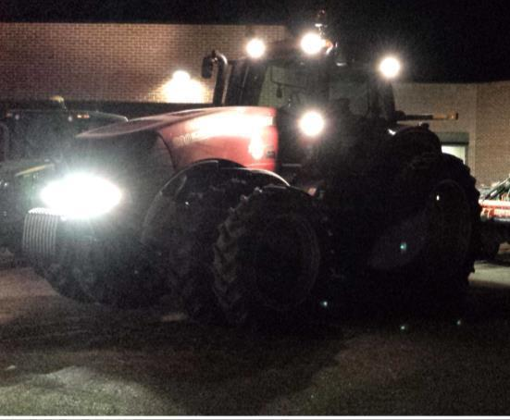
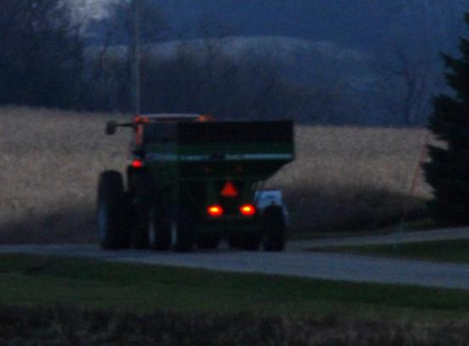
What does this mean?
Current Marking and Lighting Standards
It means that
2 headlamps
and at least
1 red tail lamp are required!
Work lights should not be used when operating on roads.
Notes:
For

Slide 48
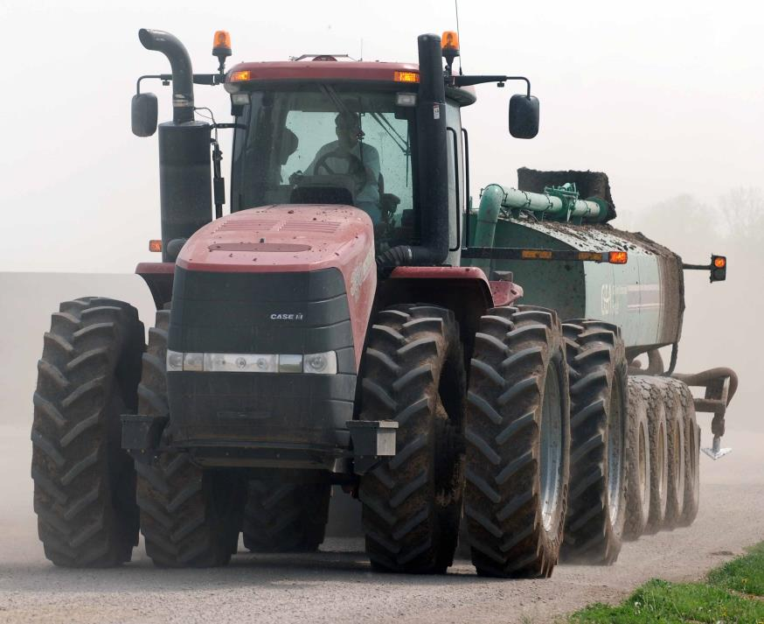
During hours of darkness, any IOH that extends 4 feet or more to the left of the centerline of the power unit, requires
Current Marking and Lighting Standards
Hours of Darkness: 340.01(23)
1 amber reflector mounted on the left side facing forward marking the extreme width

Slide 49
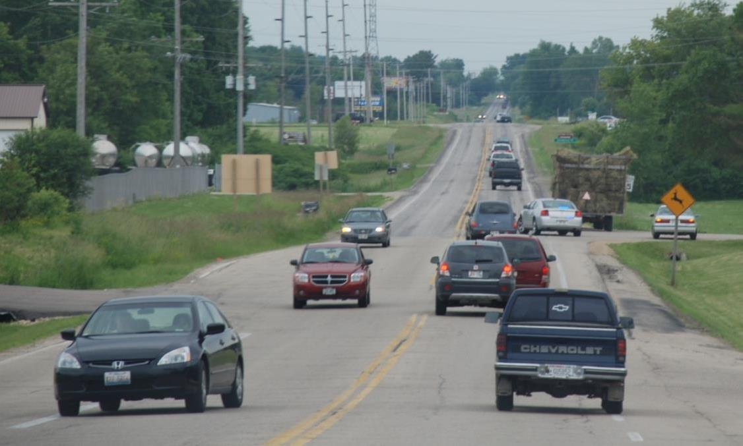
Rules of the Road
Notes:
Photo source: CA Skjolaas

Slide 50
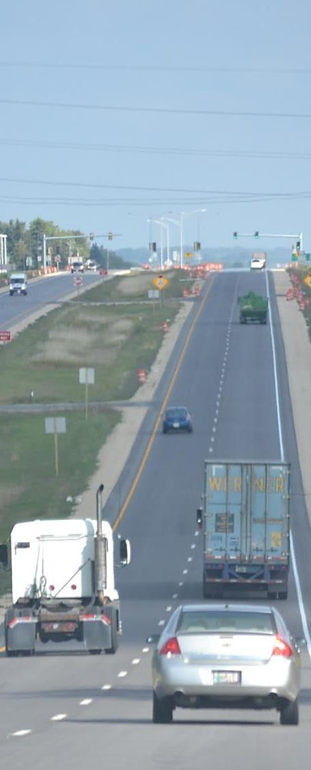
Rules of the Road
Wide IoH (15 feet +) with required lighting and marking requirements may:
Extend over the center of road into the lane intended for travel in opposite direction
Extend into passing lane on a 3-lane highway
Extend into another lane intended for travel in the same direction, if it does not impede other vehicles from the rear
Notes:
Use escort vehicles

Slide 51
Rules of the Road
Rules of the Road
HOWEVER:
Must yield the right of way to an oncoming vehicle and yield half of the roadway
May not drive on left side of roadway on a grade or curve or an area designated as no passing zone if it creates a hazard to oncoming traffic

Slide 52
Rules of the Road
HOWEVER:
May not drive so slowly as to impede the normal movement of traffic
Must, if practicable, yield the roadway to an overtaking vehicle
Act 377 repeals the ability for motorist to pass IoH and Ag CMV in No-Passing Zone (2012 law).

Slide 53
Local Options
Options |  | Action | Communication | Permit | Result
A | Posting Approach (§349.16) | Post roads limiting weight below 23K/92K/Wt Table | No publication required – but roads must be posted | Must respond to permit applications | Could post notice giving commodities/vehicles exemptions (e.g. milk trucks and Category B). §349.16 (3)
B | Total Opt Out §348.27 (19)5.a. | No weight or length limit on any jurisdiction road for IoH or Ag CMVs | Must pass and post/publish ordinance or resolution. Also posted on DOT website. | No permits necessary | IoH or Ag CMVs of any weight or length can run on roads subject to seasonal and special postings
C | Partial Opt Out I | Sets weight limit above 23K/92K/Wt Table on all roads under jurisdiction | Must pass and post/publish ordinance or resolution. Also posted on DOT website. | Must respond to permit applications | IoH or Ag CMVs can run up to set limits without permit subject to seasonal and special postings
D | Partial Opt Out II §348.27 (19)5.c. | Designates roads for over-weight/over-length IoH and Ag CMVs | Must pass and post/publish ordinance or resolution. Also posted on DOT website. | Must respond to permit applications | IoH or Ag CMVs can run up to set limits on designated roads without permit subject to seasonal and special postings
E | Opt In §348.15 (9)(f)2.a. State highways fall into this category | Pass ordinance requiring Category B and all IoH/Ag CMVs to follow 23K/92K/Wt Table | Must pass and post/publish ordinance or resolution. Also posted on DOT website. State Highway operate like this per 348.15 (9)(f)3 | Must respond to permit applications | IoH and Ag CMVs must apply for permit to exceed 23K/92K/ Wt Table
F | Abides by Act 377 | No special action taken – 23K/92K/Table governs IoH and Ag CMVs – except Category B (no axle limit/ 92K GVW) | No publishing required | Must respond to permit applications | IoH and Ag CMVs must apply for permit to exceed 23K/92K/Table; Category B must apply for permit to exceed 92K GVW
Notes:
Table of Local options that are individually covered in the next 6 slides. Make reference to handout that has this table.

Slide 54
Local MA options
“No-Fee Permit”
Notes:
Range of options for maintaining authorities.
Reminder limit of 92/23 – weight table on state highways

Slide 55
IoH/Ag CMV Permits
Permit applications available on Website: www.Ag.Vehicles.DOT.wi.gov
Permit Information is not open to public inspection, copying or disclosure
Notes:
Information required to apply to operate on State Highways per the IoH/Ag CMV weight table

Slide 56
IoH/Ag CMV Permits
“No-Fee Permit” (NFP) may be available to exceed weight and length limits
Issued by maintaining authority (MA)
Requires MA to provide approved route for Category B operation if permit application denied – may include conditions of operations
Notes:
Wanted to remove barriers to your planting, harvesting operations
Also – this equipment is has a limited time use.

Slide 57
IoH/Ag CMV Permits
Upon receipt of application for “No-Fee Permit”
MA provides a final decision within 3 weeks
If MA fails to approve or deny within 3 weeks, application is considered approved until applicant receives a denial or 6 weeks from receipt of application.
If MA fails to approve or deny within 6 weeks of receipt, application is approved.
MA may issue consecutive month or annual permits or for longer time period
State will send a duplicate permit on an annual basis if there are no changes to state road or bridge conditions on route

Slide 58
Vehicle Measurements
AXLE 1 GAUGE
AXLE 2 GAUGE
AXLE 4 GAUGE
AXLE 3 GAUGE
AXLE SPACING 1
AXLE SPACING 2
AXLE SPACING 3
Column A
AXLE 1 Weight
AXLE 2 Weight
AXLE 3 Weight
AXLE 4 Weight

Slide 59
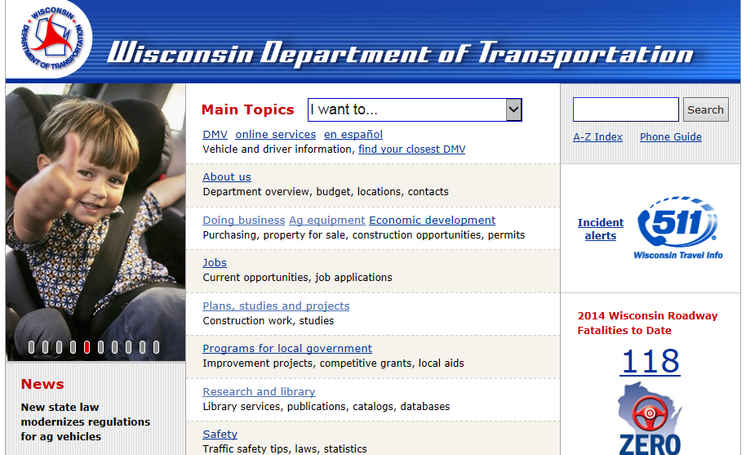
Further information:
Website: www.AgVehicles.DOT.wi.gov
Email: AgVehicles@dot.wi.gov
State Hwy Permit Phone: 608-266-7320
Contact your dealer for specific equipment details
Screen shot of website?

Slide 60
This information was prepared by the Education and Outreach Committee of the IoH Study Group, representing Wisconsin Department of Transportation, Wisconsin Department of Agricultural Trade and Consumer Protection, University of Wisconsin Extension/Madison, Wisconsin Farm Bureau Federation, Professional Nutrient Applicators Association of Wisconsin, and Wisconsin Independent Business Agri-Business Coalition.
Information is provided as guidance. For legal reference see Wisconsin Act 377 available at www.wisconsin.gov.

